Slide 1
SAX Parser
Service-Oriented Software Engineering
Software Institute
Nanjing University
Bei Jia

Slide 2
SAX Basics
Simple interface for event-based parsing
  A specific method is called for each event fired
SAX is efficient, but simple
  The less work the parser does, the more the application needs to do
Application must track state
  You handle the events as you see fit
  Program must track its location within the document
  Once an event is fired, the parser forgets about it
  If you don't store the data it is lost
  Application may need to buffer events it cares about
SAX can be considered to create a tree implicitly
  A Start tag indicates going down one level
  An End tag indicates moving up one level

Slide 3
When to Use SAX
When you need to scan large XML documents
  Scan huge files with little overhead
You need more control over the parsing process
  SAX doesn't actually do much
  Your program decides how anything is used, if at all
You have limited system resources
  Memory and processor
  SAX doesn't create many objects
You need high performance
  Quickly read and locate elements within any size XML document

Slide 4
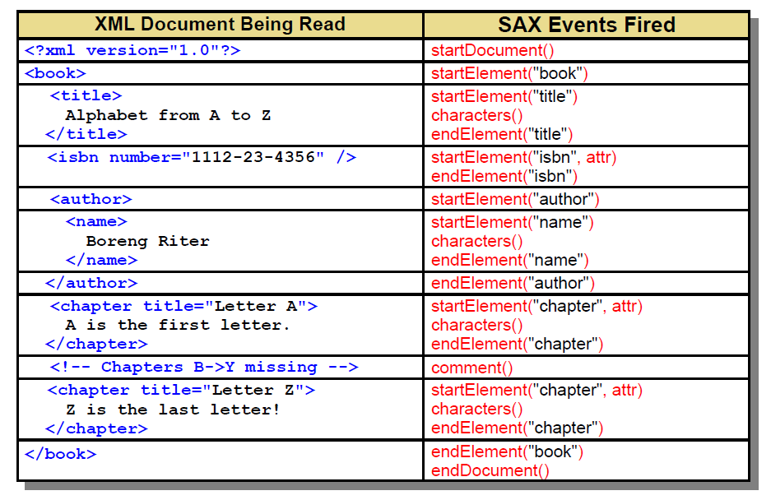
SAX Event Timeline

Slide 5
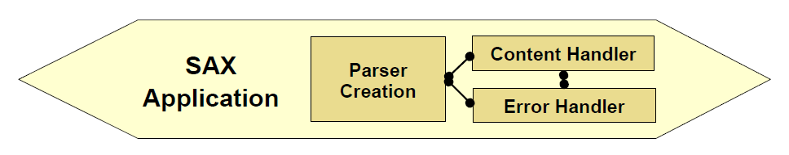
Structure of a SAX Application
Typical SAX applications consist of three basic section. Each of these may represent a discreet class or be combined into a single class
  Parser creation and configuration
    Seven steps to create, configure, and start the parser
  Content Handler Methods
    Handles all normal events fired by the parser
    All the real work occurs
  Error Handler Methods
    Deals with any errors that occur during the parse

Slide 6
Parser Creation: Seven Steps (1/2)
Step 1: Create a new instance of SAXParserFactory
  JAXP dynamically locates the real SAX implementation
  The application doesn't care what SAX parser is used
Step 2: Set any desired parsing options
  Some behaviors of the parser can be altered
  All available features and properties are shown later
Step 3: Create a JAXP SAX parser from the factory
  Multiple parsers can be generated from a single factory
Step 4: Get an encapsulated XMLReader from the parser
  Returns an XMLReader from the implementation class

Slide 7
Parser Creation: Seven Steps (2/2)
Step 5: Create and register a Content Handler class
  Custom class that handles all normal events received from the parser
Step 6: Create and register an Error Handler
  Custom class that deals with parsing errors.
Step 7: Begin the parsing process
  A simple call to parse() is all it takes to begin the entire process

Slide 8
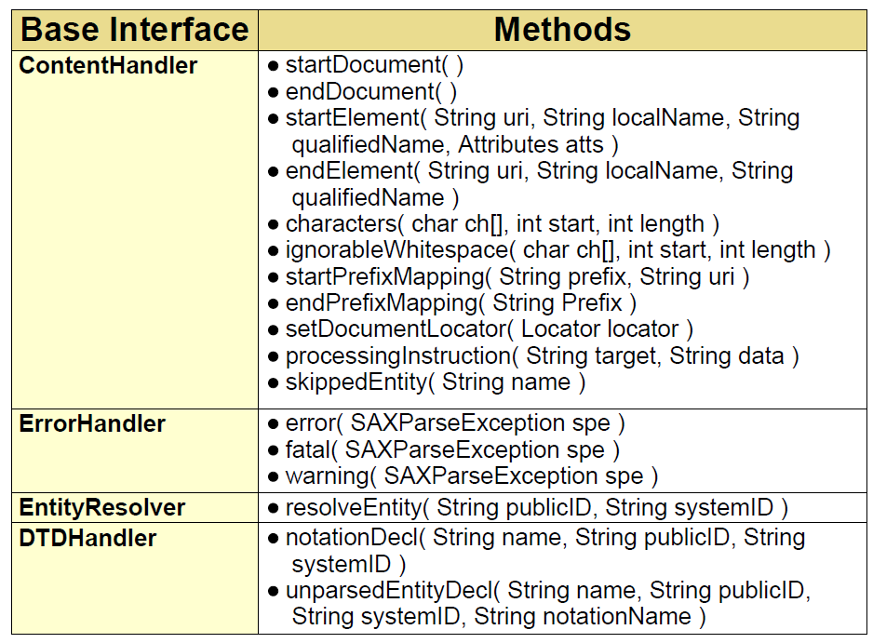
Overridable Methods in DefaultHandler

Slide 9
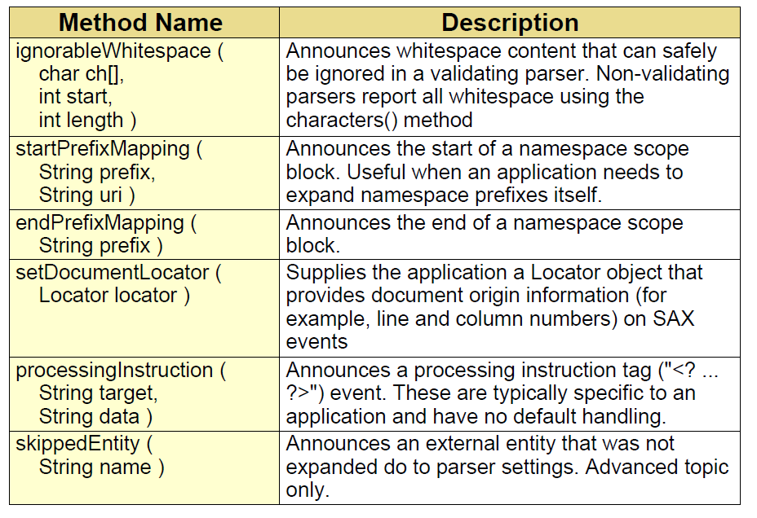
Content Handler: Other Methods

Slide 10
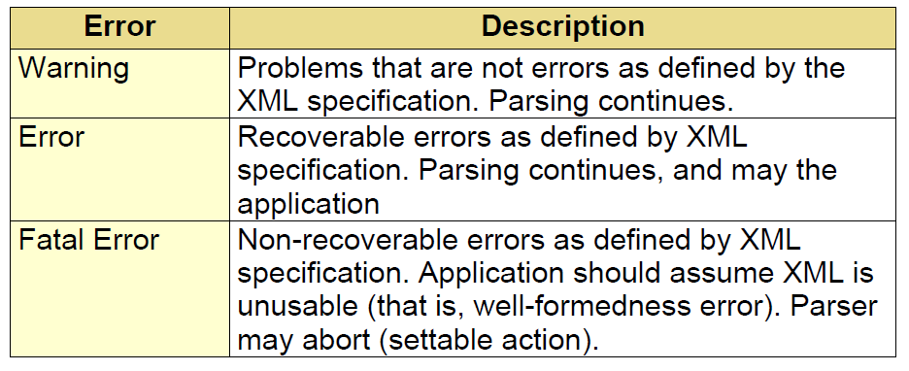
Handling Errors during Parsing
Create a customer Error Handling class
  Implement the org.xml.sax.ErrorHandler Interface
  Inform parser with xmlRdrInstance.setErrorHandler()
Default behavior is to take no action on most errors
  Not a desirable feature in an application
Provide custom actions for the three error conditions

Slide 11
Maintaining State in SAX Programs
In most SAX applications, you need to track the state of the parsing process
  The current element
  The current element's parent and grandparents
  Count of sibling elements
  Any siblings that have already been seen
The application must be aware of the XML structure
  Enforced with a validating parser and the DTD/Schema
Common methods for tracking application state are:
  Integer constants representing element levels
  LIFO buffer to push and pop element names as they are started and ended
  Hierarchical class structure (Build your own DOM)

